Slide 1


Adaptive Traffic Light Control System
SUBMITTED BY:
Bhoomi Chauhan (2420694)
Bhoomika Rana (2420695)
Bhumika (2420696)
Bitu Sahu(2420697)
Nov 2025
Department of Artificial Intelligence and Data Science Chandigarh Engineering College Jhanjeri Mohali - 1040307

Slide 2
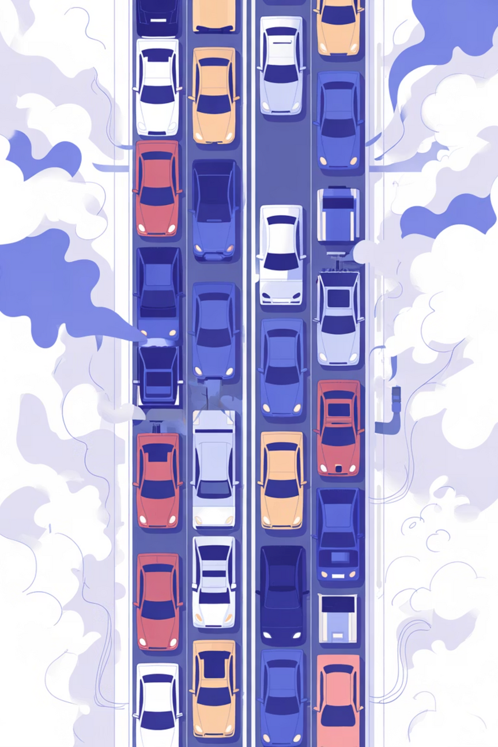
The Challenge of Urban Traffic
Current Problems
The Smart Solution
Traditional traffic systems use fixed timers that don't respond to actual road conditions. This leads to:
Our Adaptive Traffic Light Control System uses real-time data and AI to dynamically adjust signal timing based on actual traffic density.
Unnecessary waiting at empty intersections
The result: reduced congestion, shorter travel times, and a more sustainable urban environment.
Increased congestion during peak hours
Delayed emergency response times
Wasted fuel and higher emissions

Slide 3



Project Overview
Intelligent Detection
Dynamic Control
Eco-Friendly Impact
Cameras and sensors capture real-time traffic density at intersections
AI algorithms automatically adjust red and green light durations based on current conditions
Reduced idle time means lower fuel consumption and decreased air pollution
Unlike conventional systems that rely on pre-programmed timers, our solution continuously adapts to changing traffic patterns throughout the day, ensuring optimal flow at every moment.

Slide 4
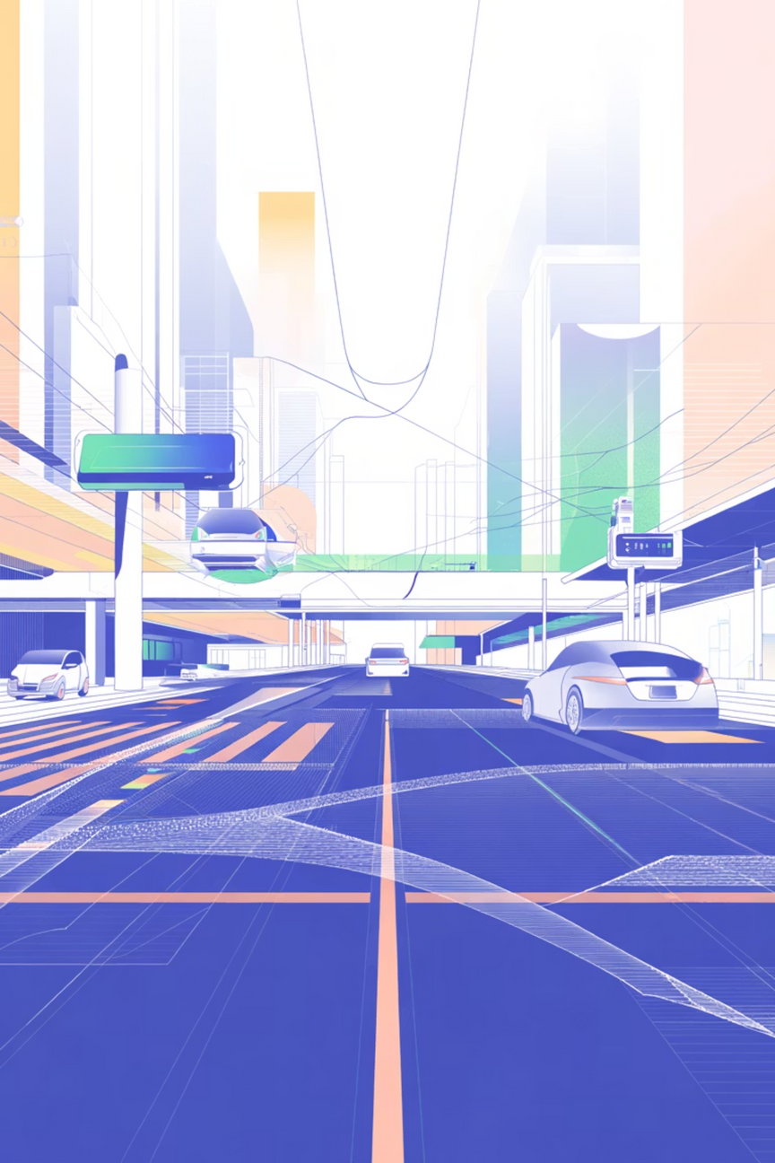
Project Aim
1
2
Optimize Traffic Flow
Minimize Wait Times
Automatically control signal timings using real-time traffic data analysis
Eliminate unnecessary delays on less congested roads while prioritizing busier routes
3
Enable Smart Management
Create an intelligent, adaptive system that's both efficient and environmentally sustainable

Slide 5
Problem Statements
Inefficient Fixed Timers
Rising Congestion Crisis
Traditional traffic lights operate on predetermined schedules, causing vehicles to wait unnecessarily at empty intersections regardless of actual traffic conditions.
Growing urban populations lead to severe traffic jams, resulting in extended travel times, excessive fuel consumption, and increased environmental pollution.
Emergency Response Delays
Lack of Adaptive Systems
Rigid signal patterns prevent ambulances, fire trucks, and police vehicles from quickly reaching their destinations, potentially costing lives.
Most cities worldwide still operate without intelligent, real-time traffic management infrastructure despite available technology.

Slide 6
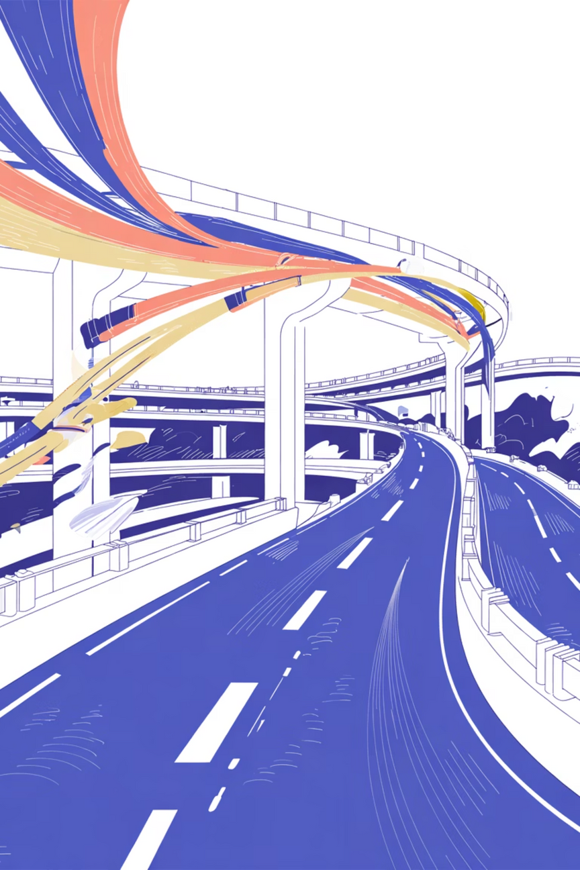
Research Insights
Key Findings
30%
Our research reveals significant opportunities for improvement in urban traffic management:
Congestion Reduction
Traditional systems rely on manual control or static timers, proven inefficient for modern traffic volumes
Potential decrease with adaptive AI systems
AI-powered adaptive systems can reduce congestion by up to 30% in real-world implementations
Emerging technologies like IoT, computer vision, and machine learning are transforming traffic systems globally
Advanced models including fuzzy logic and reinforcement learning show promise for dynamic signal optimization

Slide 7
Project Objectives
Vehicle Detection System
1
Design and implement a system that accurately detects and counts vehicles using camera or sensor data at intersections
Control Algorithm Development
2
Develop a robust Python-based control algorithm that dynamically adjusts signal timings based on real-time traffic density
Real-Time Simulation
3
Create a comprehensive simulation of live traffic scenarios using OpenCV or Pygame for testing and validation
Performance Comparison
4
Conduct thorough analysis comparing the adaptive system's efficiency against traditional static signal systems

Slide 8




System Architecture
Data Collection
Cameras and sensors capture vehicle counts and traffic patterns
AI Processing
Machine learning algorithms analyze density and predict optimal timing
Signal Control
System adjusts light duration dynamically based on real-time conditions
The system operates in a continuous feedback loop, constantly monitoring conditions and adapting to ensure smooth traffic flow throughout the day.

Slide 9
Project Scope & Applications
Smart City Integration
Emergency Priority
Environmental Benefits
Deploy across urban areas for comprehensive traffic management and improved quality of life
Enable priority routing for ambulances, fire trucks, and police vehicles to save critical time
Significantly reduce fuel consumption and air pollution through optimized traffic flow

Slide 10
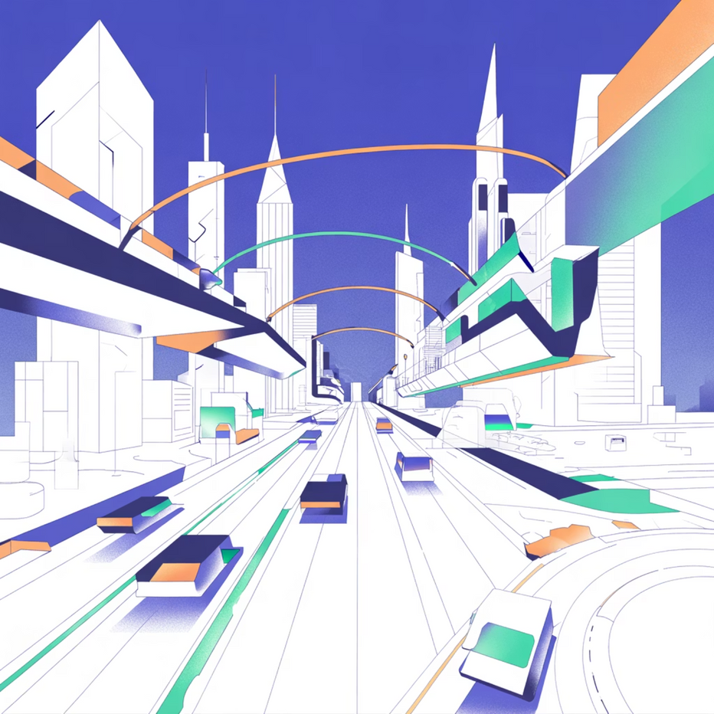

Future Enhancements
IoT Network Integration
1
Connect with city-wide sensor networks for comprehensive traffic monitoring
2
Navigation App Sync
Integrate with Google Maps and other platforms to provide real-time routing updates
Cloud Analytics
3
Deploy cloud-based machine learning for predictive traffic management at scale
4
Multi-City Deployment
Expand system architecture for large-scale metropolitan implementations
Vision for Tomorrow: Our adaptive traffic system represents just the beginning of intelligent urban infrastructure. With continued development, it can transform how cities manage transportation at every level.

